Slide 1
CS3300: Operating Systems
P.Krishna Reddy
pkreddy@iiit.net

Slide 2
Outline
Introduction
  What is an Operating System ?
Course topics and grading
History, development and concepts of Oss (Stallings, 2.2 and 2.3)
Different kinds of Computer Systems
(Silberschatz, Chapter 1)
Concept of virtual computer
(Crowley, Chapter 1)

Slide 3
Questions
What is a system ?
What is an operating system ?
What is a computer operating system ?

Slide 4
What is a system ?
A system is an inter-related set of components with an identifiable boundary working together for some purpose.
System can be natural of fabricated
  Natural systems: human body or solar system
  Fabricated systems: cycle, bus, computer, government, boat

Slide 5
System
boundary
A system has nine characteristics
  Components
  Inter-related components
  A boundary
  A purpose
  An environment
  Interfaces
  Input
  Output
  Constraints.
input
interfaces
environment
Components
interfaces
Inter-realtionship
output
A general depiction of a system

Slide 6
Characteristics…
Components:
  A system is made up of components
  A component is either an irreducible part or aggregation of parts that make-up a system. A component is also called a sub-system.
Interrelated:
  The components of interrelated
  Dependence of one subsystem on one or more subsystems.

Slide 7
Characteristics…
Boundary (Scope):
  A system has a boundary, within which all of its components are contained and which establishes the limits of a separating the system from other systems.
Purpose
  The overall goal of function of a system. The system’s reason for existing.

Slide 8
Characteristics…
Environment
  Everything external to the system that interacts with the system.
Interface
  Point of contact where a system meets its environment or subsystems meet each other.
Constraint:
  A limit what a system can accomplish: Capacity, speed or capabilities.

Slide 9
Characteristics…
Input
  Whatever a system takes from its environment in order to fulfill its purpose.
Output:
  Whatever a system returns to its environment in order to fulfill its purpose.

Slide 10
Example: A fast food restaurant as a system
Output:
Prepared food,
Bank deposits,
Trash
Input:
Food, labor,
Cash, etc.
Storage
Office
Dining
room
Kitchen
Counter
Boundary
Environment: Customers, food distributors, banks etc
Represents an inter-relationship
Constraints: Popular foods, Health dept., constraints of storage

Slide 11
Important System Concepts
Decomposition
Modularity
Coupling
Cohesion

Slide 12
Decomposition (Divide and Conquer)
  It deals with being able to break down a system into its components.
  Decomposition results in smaller and less complex pieces that are easier to understand than larger, complex pieces.
  Decomposing a system also allows to focus on one particular part of a system, making easier to think of how to modify that part independently of the entire system.

Slide 13
Modularity
Modularity refers to dividing a system up into chunks or modules of a relatively uniform size.
You can replace or add any other module (or a component) without effecting the rest of the system.
It is a design strategy in which system is composed of relatively small and autonomous routines fit together.

Slide 14
Coupling
Coupling is the extent to which subsystems are dependent on each other.
Subsystems should be as independent as possible.
If a subsystem fails and other subsystems are highly dependent on it, the others will either fail themselves or have problems in functioning.

Slide 15
Cohesion
The extent to which a system or a subsystem performs a single function.

Slide 16
What is an operating system ?
Operating system is a system.
Operating system is a subsystem of any tool.
Each tool constitutes machine part and operating part.
The operating part of a tool is called operating system of that tool.
The purpose of operating system is to facilitate the operation of the underlying machine or tool.
For some tools, operating system may not exist.
  Example: Pen.
For a machine, the operating system abstracts the machine part in terms of simple services by hiding the details of the machine. The OS can provide services to users or other subsystems.
Examples of typical operating systems:
  Car operating system, Telephone operating system, TV operating system and so on.

Slide 17
What is a computer operating system ?
A computer is also a tool that contains machine part and operating part.
The operating part of a computer is called Computer Operating System.
For a computer, the operating system abstracts the underlying hardware in terms of simple services by hiding the details of the hardware. The OS can provide services to users or other subsystems.
Examples of Computer operating systems:
  WINDOWS NT, WINDOWS XP, Macintosh, UNIX, SOLARIS, LINUX and so on.
In the rest of this course, operating system means computer operating system.

Slide 18
Computer System Components
1. Hardware – provides basic computing resources (CPU, memory, I/O devices).
2. Operating system – controls and coordinates the use of the hardware among the various application programs for the various users.
3. Applications programs – define the ways in which the system resources are used to solve the computing problems of the users (compilers, database systems, video games, business programs).
4. Users (people, machines, other computers).

Slide 19

Abstract View of System Components

Slide 20
What is an Operating System?...
A program that acts as an intermediary between a user of a computer and the computer hardware.
Operating system goals:
  Make the computer system convenient to use.
  Use the computer hardware in an efficient manner.

Slide 21
Operating System Definitions…
Resource allocator – manages and allocates resources.
  Resources: CPU time, Memory Space, file storage space, I/O devices and son on.
Control program – controls the execution of user programs and operations of I/O devices .
Kernel – the one program running at all times (all else being application programs).
The two goals, efficiency and convenience are sometimes contradictory
Much of OS theory is concentrates optimal use of resources.

Slide 22
Outline
Introduction
  What is an Operating System ?
Course topics and grading
History, development and concepts of Oss (Stallings, 2.2 and 2.3)
Different kinds of Computer Systems
(Silberschatz, Chapter 1)
Concept of virtual computer
(Crowley, Chapter 1)

Slide 23
Objectives
The main objective is to understand the operational part of any computer.
Understanding the general principles of OS design.
  Focus on general-purpose, multi-user, uni-processor systems.
  Emphasis on widely applicable concepts rather than any specific features of any specific OS.
Understanding problems, solutions and design choices.
Understanding the structure of specific OSs: UNIX, LINUX, WINDOWS2000

Slide 24
Course topics
Introduction (6 hours )
Process management (8)
CPU scheduling (4)
Process synchronization (6)
Deadlocks (3)
Memory management (3)
Virtual memory (3)
File systems (3)
Protection and security (3)
Overview of classical operating systems. (3)

Slide 25
References
Text books:
  Silberschatz, A, Galvin, P, Gagne, G. Operating System Concepts, Addison-Wesley (5th or latest edition).
Other BOOKS::
  Charles Crowley, Operating Systems: A design-oriented approach, Tata McGraw-Hill, 1997.
  William Stallings, Operating systems, Prentice-Hall, 1998.
  Tanenbaum, A., Modern Operating Systems, Prentice-Hall, second edition, 2000.

Slide 26
LAB WORK
Experiments will be given on Linux.
Sample experiments
  Shell writing for MSDOS
  Process Communication
    Bounded buffer
      Semaphores, shared memory based communication
      Threads
  Replace “ls” with lookup
  Command line for /proc
  Printer driver
  Adding a new system call to linux
The lab is very intensive. Please do not ask for the extension of deadline. Each experiment will be evaluated.

Slide 27
OUTCOME
After completing the course, the students will understand
  the fundamental concepts of several computer operating systems such as SOLARIS, LINUX, WINDOWS and MAC.
  the solutions/options to interesting problems which have been encountered by the designers of preceding operating systems.
  the critical role of operation system in designing several computer based systems like database systems, expert systems, web based information systems, real-time systems, embedded systems and so on.

Slide 28
GRADING
MIDTERM I: 15 %
MIDTERM II: 15 %
ENDSEM EXAM: 40 %
LAB: 30%

Slide 29
Outline
Introduction
  What is an Operating System ?
Course topics and grading
History, development and concepts of Oss (Stallings, 2.2 and 2.3)
Different kinds of Computer Systems
(Silberschatz, Chapter 1)
Concept of virtual computer
(Crowley, Chapter 1)

Slide 30
Early systems (Serial processing)
1940-50:
  The programmer interacted directly with the computer hardware.
  Display light, switches, printer, card reader.
  No OS.
  Error is displayed through lights.
Problems:
  Scheduling → Users spend lots of time at the computer.
    Signup sheet was used.
  Job Setup time
    Loading and compiling
      Mounting and Un-mounting of tapes
      Setting up of card desks
  Libraries of functions, linkers, loaders, debuggers, and I/O driver routines were available for all the users.

Slide 31
Early Systems…
Early computers were (physically) large machines run from a console.
The programmer would operate the program directly from the console.
  The program is loaded to the memory from panel of switches, paper tape, and from punched cards.
As time went on, additional software and hardware were developed.
  Card readers, line printers, and magnetic tape became common place.
  Libraries, loaders, and common functions were created.
    Software reusability.

Slide 32
Early Systems…
The routines that performed I/O were especially became important.
Device driver: A special subroutine was written for each I/O device.
  A device driver knows how the buffers, flags, registers, control bits, and status bits for a particular device should be used.
  Device driver is written once and called from the library.
Later, compilers for FORTRAN, COBOL and other languages have appeared.
  To prepare a FORTRAN program for execution:
    Load the FORTRAN compiler
    Mount compiler tape
    Program would be read from the card reader.
    Assembly program produced by the compiler would be linked to supporting library routines.
    Finally, the binary code is ready to execute.
    It would be loaded into the memory and debugged from the console.

Slide 33
Early Systems…
Significant amount of setup time.
Each job consisted of many separate steps:
  Loading the FORTRAN compiler tape
  Running the compiler
  Unloading the compiler tape
  Loading of assembler tape
  Running assembler
  Unloading the assemble tape
  Loading the object program
  Running the object program
If error occurred during any step, you have to start over at the beginning.

Slide 34
Early Systems..
The setup time was a real problem
CPU is idle while tapes are being mounted or the programmer was operating the console.
In the early days, few computers were available and they were expensive (millions of dollars).
  +operational costs: power, cooling, programmers.
Main question: how to increase the utilization of CPU ?

Slide 35
Early Systems…
The solution was two fold.
First, a professional computer operator was hired.
  Once the program was finished, he operator could start next job.
  The operator sets up the job, produces the dump, and starts the next job.
  The set up time was reduced due to operator’s experience.
Second, jobs with similar needs were batched together and run through the computer as a group.
  For example, if there is a FORTRAN job, COBOL job, and FORTRAN job, two FORTRAN jobs were batched together.
However, during transition time CPU sat idle.
To overcome this idle time, people developed automatic job sequencing.
  A first rudimentary OS was created
  A small program called a resident monitor was developed.
  The resident monitor always resided in memory.

Slide 36
Simple Batch Systems ( early 1960s)
In serial systems
  Machines were very expensive
  Wasting time was not acceptable.
To improve usage, the concept of batch OS was developed.
The main idea is the use of software known as monitor.
  The user no longer has access to machine.
The user submits the job (tape) to the operator.
The operator batches the jobs together sequentially, places entire batch as an input device for use by the computer.

Slide 37
Memory Layout for a Simple Batch System
Interrupt procedures
Device drivers
Monitor
Job sequencing
Command language
interpreter
Boundary
User program
area
Resident monitor

Slide 38
Simple Batch Systems..
At the beginning of any job, the corresponding subroutines and functions are loaded.
The monitor reads the jobs one at a time from the input device.
Algorithm:
  The control is passed to the user’s program.
    Processor is fetching and executing user’s instructions.
  After completion, the control is returned to the monitor program
    Processor is fetching and executing monitor instructions.

Slide 39
Features of Batch System
The batch OS is simply a program. It relies on the ability of the processor to fetch instructions from various portions of main memory to seize and relinquish control.
Hardware features:
  Memory protection: While the user program is running, it must not alter the memory area containing the monitor.
  If such is the case the processor hardware should detect the error and transfer control to monitor.
  Timer: A timer is used to prevent the single job from monopolizing the system
  Privileged instructions
    Contains instructions that are only executed by monitor.
    I/O instructions
    If a program encounters them the control shifts through monitor..
  Interrupts: It gives OS more flexibility.

Slide 40
Features of Batch System
With batch OS the machine time alters between execution of user programs and execution of monitor.
Two overheads
  Machine time is consumed by the monitor.
  Memory is consumed by the monitor.
Still, they improved the performance over serial systems.

Slide 41
Problems with Batch System
CPU is idle
Speed of mechanical devices is very slower than those of electronic devices.
CPU works in a microsecond range
  Thousands of instructions/second
A card reader may read 1200 cards per minute (20 cards per second)
CPU speed has increased at a faster rate.
Main perceived problem
  Turn-around time: up to two days
  CPU often underutilized
    Most of the time was spent reading and writing from tape.

Slide 42
Resident monitor: summary
Automatic job sequencing
  Use of control cards
Job control language
  Commands
    Mount this tape
    Compile
    Run
OSs begin to be important.
  IBM: Fortran monitor system
Main perceived problems
  Turn-around time
  Inexpensive use of expensive hardware
  CPU is still mostly idle.

Slide 43
Spooling
The introduction of disk technology helped in this regard.
Disk technology introduced the spooling (Simultaneous Peripheral Operations On-Line)
Considers disk as a huge buffer.
Input comes from the disk
Output goes to the disk.
DISK
Card
Reader
Line
Printer
CPU

Slide 44
Advantage of Spooling
Reading can be done in advance.
Output can be stored on the disk.
Spooling is also used for processing data at remote sites.
Spooling overlaps the I/O of one job and computation of other jobs.
Even printing and reading can overlap.
Spooling can keep both the CPU and the I/O devices working at higher rates.

Slide 45

Multi-programmed Batched Systems
(1960s)
A single user can not keep either CPU or I/O busy.
Multiprogramming increases CPU utilization by organizing jobs such that the CPU always has one to execute.
The OS keeps several jobs in memory at a time and CPU is multiplexed among them

Slide 46
Multi-programmed Batch Systems
If CPU is executing a job and requires a tape to be mounted
  In a non multi-programmed system
    CPU sits idle.
  In a Multi-programmed system
    CPU takes up another job.
Multiprogramming is the first instance when the OS started taking decisions.
Job scheduling is done by OS.
Having several programs in the memory requires memory management.

Slide 47
OS Features Needed for Multiprogramming
I/O routine supplied by the system.
Memory management – the system must allocate the memory to several jobs.
CPU scheduling – the system must choose among several jobs ready to run.
Allocation of devices.

Slide 48
Time-Sharing Systems–Interactive Computing
Programs could interact with user.
Programs
  Could wait for I/O for arbitrary time
    CPU switched to another job.
    However, resident jobs took up valuable memory
      Needed to be sapped out to disk
      Virtual memory.
Time-sharing systems were developed to provide interactive use of a computer system at a reasonable cost.

Slide 49
Time-Sharing Systems–Interactive Computing
A TSS uses CPU scheduling and multi-programming to provide each user with a small portion of a time shared computer.
A program that is loaded into a memory and is executing is commonly known as a process.
In timesharing system, a process executes for only a short time.
  I/O is at people speeds, but OS can switch rapidly.
A time-shared OS system allows the many users to share the computer simultaneously.
It gives the impression that the user has own computer, whereas actually a computer is shared among many users.

Slide 50
Time-Sharing Systems…
Multiprogramming and timesharing are the central themes of modern OSs.
Multiprogramming and timesharing requires
  Memory management and protection
  Virtual memory: A program is bigger than physical memory
  Online file systems.
  Disk management
  CPU scheduling
  Process synchronization and communication
  Deadlock detection

Slide 51
OS requirements (1960s and late 1960s)
OS Research in 60s
  MULTICS at MIT
  Atlas (spooling, demand paging) at Manchester Univ.
OS research (late 1960s)
  Multiprogramming
    Memory allocation and protection
    I/O operations were responsibility of OS.
  Interactive systems
    Scheduling issues
    Swapping and virtual memory.
  Users wanted permanent files
    Hierarchical directory systems.
OSs in 1960s
  Increased in size and complexity
  Were not well understood
    IBM: OS/360

Slide 52
UNIX (early 1970s)
Originally developed at Bell labs for the PDP-7
  Ken Thomson
  Dennis Ritchie
Smaller & Simpler
  Process spawn and control
    Each command creates a new process
  Simple inter-process communication
  Command interpreter not built in: runs as a user process
  Files were streams of bytes.
  Hierarchical file system
Advantages
  Written in a high-level language
  Distributed in source form
  Powerful OS primitives on an inexpensive platform

Slide 53
Personal Computers (1980s)
Originally
  Single user
  Simplified OSs
    No memory protection
    MS-DOS
Now run sophisticated OSs
  Windows NT, Linux
Windowing Systems (1980s)
Originally based on work at Xerox Parc
Popularized by the Macintosh
Characterized by
  Graphical user interface
  Mouse control

Slide 54
Networks of workstations ( 1990s)
High-speed network connections
Local & world-wide
Client-server systems
  File systems
  Remote windowing systems
Support a variety of node OSs
  Unix, Windows XP, OS/2

Slide 55
Future
Distributed systems
  Network is invisible
Micro-kernal and extensible OSs
  Supports multiple OS flavors
    E.g., Mach, Amoeba, WINDOWS XP
Embedded services and network computers
  Computer runs a very thin OS (Java Virtual machine).

Slide 56

Migration of Operating-System Concepts and Features

Slide 57
Outline
Introduction
  What is an Operating System ?
Course topics and grading
History, development and concepts of Oss (Stallings, 2.2 and 2.3)
Different kinds of Computer Systems
(Silberschatz, Chapter 1)
Concept of virtual computer
(Crowley, Chapter 1)

Slide 58
Different Kinds of Computer Systems
Multiprocessor Systems
Distributed Systems
Real-time systems

Slide 59
Multiprocessor Systems
Multiprocessor systems with more than on CPU in close communication.
Tightly coupled system – processors share memory and a clock; communication usually takes place through the shared memory.
Advantages of multiprocessor system:
  Increased throughput: more processors more work
  Economical:
  Increased reliability
    graceful degradation: failure of one processor will not halt the system. Service is proportional to the level of surviving hardware.
    Fault tolerant: Systems designed for graceful degradation.

Slide 60
Parallel Systems (Cont.)
Symmetric multiprocessing (SMP)
  Each processor runs and identical copy of the operating system.
  Many processes can run at once without performance deterioration.
  Most modern operating systems support SMP
Asymmetric multiprocessing
  Each processor is assigned a specific task; master processor schedules and allocated work to slave processors.
  More common in extremely large systems

Slide 61

Symmetric Multiprocessing Architecture

Slide 62
Distributed Systems
Distribute the computation among several physical processors.
Loosely coupled system –
  each processor has its own local memory;
  processors communicate with one another through various communications lines
  such as high-speed buses or telephone lines.
Advantages of distributed systems.
  Resources Sharing
    Ex: Laser printer
  Computation speed up – load sharing
  Reliability
  Communications
    Ex: E-mail

Slide 63
Real-Time Systems
Often used as a control device in a dedicated application such as controlling scientific experiments, medical imaging systems, industrial control systems, and some display systems.
Well-defined fixed-time constraints.
  A process must complete within the defined constraints or system will fail.
Real-Time systems may be either hard or soft real-time.

Slide 64
Real-Time Systems (Cont.)
Hard real-time:
  Guarantees that critical tasks complete within time.
  All the delays in the system are bounded.
  Secondary storage limited or absent, data stored in short term memory, or read-only memory (ROM)
  Conflicts with time-sharing systems, not supported by general-purpose operating systems.
Soft real-time
  Critical time tasks gets priority over other tasks, and retails that priority until it completes.
  Limited utility in industrial control of robotics
  Useful in applications (multimedia, virtual reality) requiring advanced operating-system features.

Slide 65
Outline
Introduction
  What is an Operating System ?
Course topics and grading
History, development and concepts of Oss (Stallings, 2.2 and 2.3)
Different kinds of Computer Systems
(Silberschatz, Chapter 1)
Concept of virtual computer
(Crowley, Chapter 1)

Slide 66
Concept of virtual computer
Multilevel implementation
  also called layered
Resources
  Hardware: provided to the OS
  Logical ( virtual): created by the OS
Resource management
  transformation
  multiplexing
    time and space

Slide 67
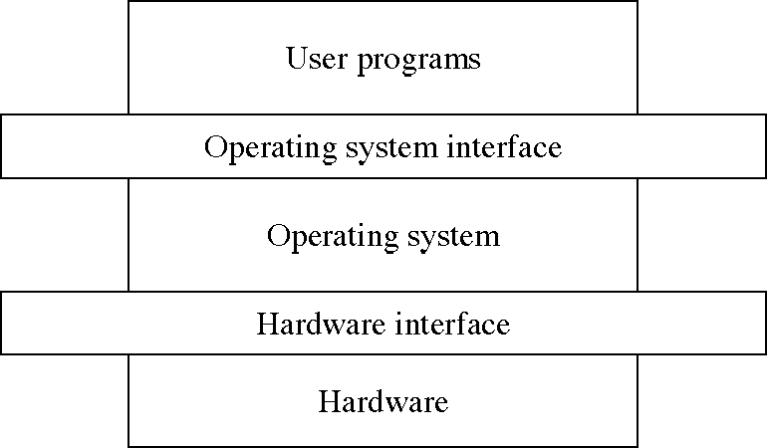
Levels in a computer system

Slide 68
Design: Two-level implementation
Two-level implementation
  Lower level is a problem-specific language
  Upper level solves the problem at hand
  Lower level is reusable
In operating systems
  mechanism: lower level of basic functions, does not change
  policy: upper level policy decisions, easy to change and experiment

Slide 69
Operating system functions
Resource manager
  manage hardware and software resources
Virtual machine manager
  implement a virtual machine for processes to run in
  a nicer environment than the bare hardware

Slide 70
Hardware resources
Processor: execute instructions
Memory: store programs and data
Input/output (I/O)controllers: transfer to and from devices
Disk devices: long-term storage
Other devices: conversion between internal and external data representations

Slide 71
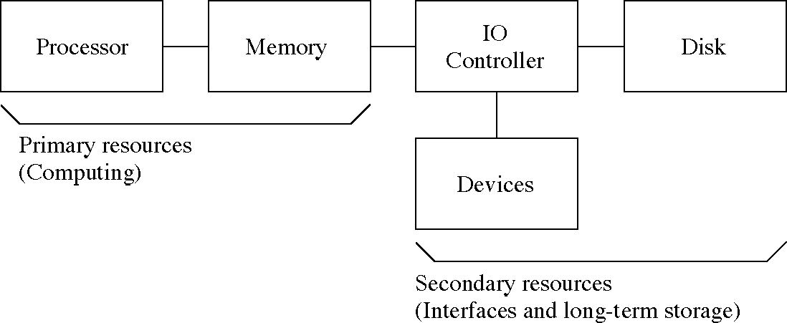
Hardware resources

Slide 72
Resource management functions
Transforming physical resources to logical resources
  Making the resources easier to use
Multiplexing one physical resource to several logical resources
  Creating multiple, logical copies of resources
Scheduling physical and logical resources
  Deciding who gets to use the resources

Slide 73
Types of multiplexing
Time multiplexing
  time-sharing
  scheduling a serially-reusable resource among several users
Space multiplexing
  space-sharing
  dividing a multiple-use resource up among several users

Slide 74
Virtual computers
Processor virtualized to processes
  mainly time-multiplexing
Memory virtualized to address spaces
  space and time multiplexing
Disks virtualized to files
  space-multiplexing
  transforming

Slide 75
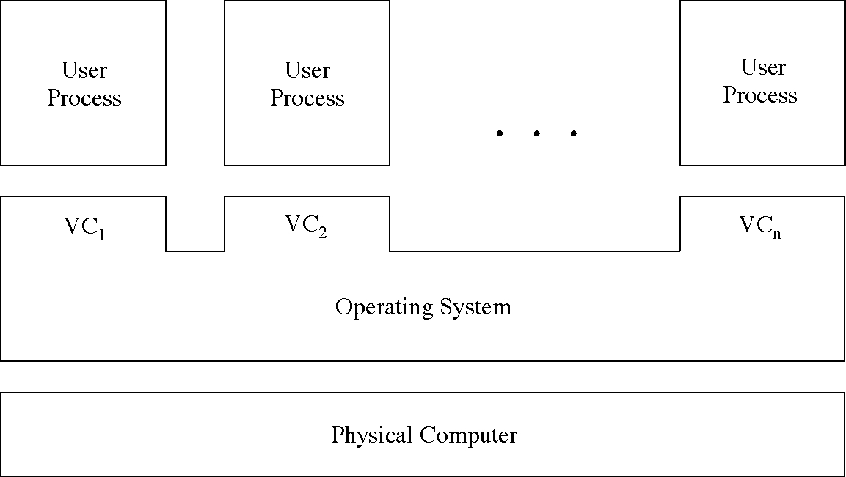
Multiple virtual computers

Slide 76
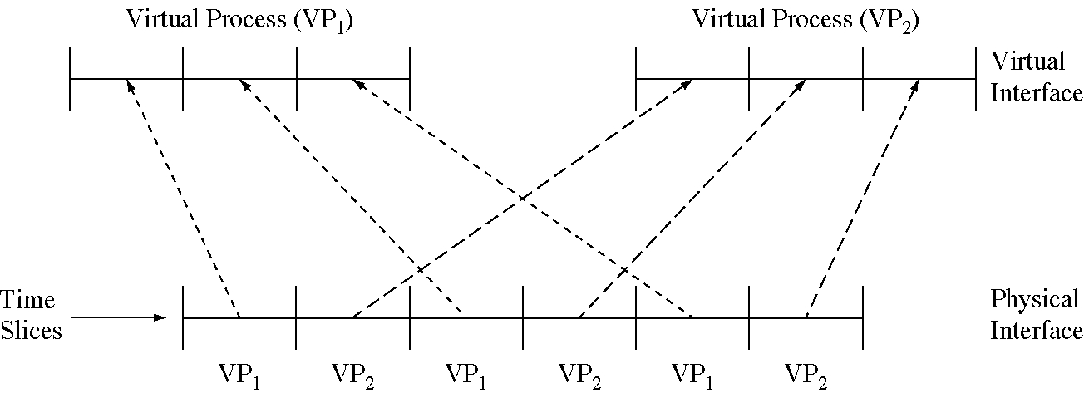
Time-multiplexing the processor

Slide 77
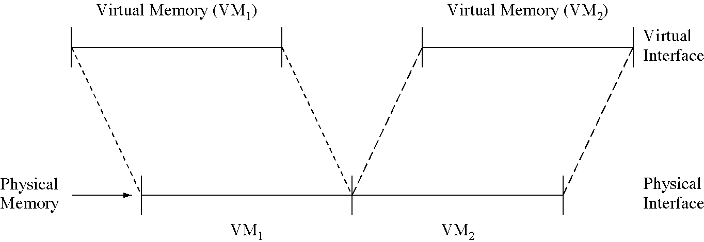
Space-multiplexing memory

Slide 78
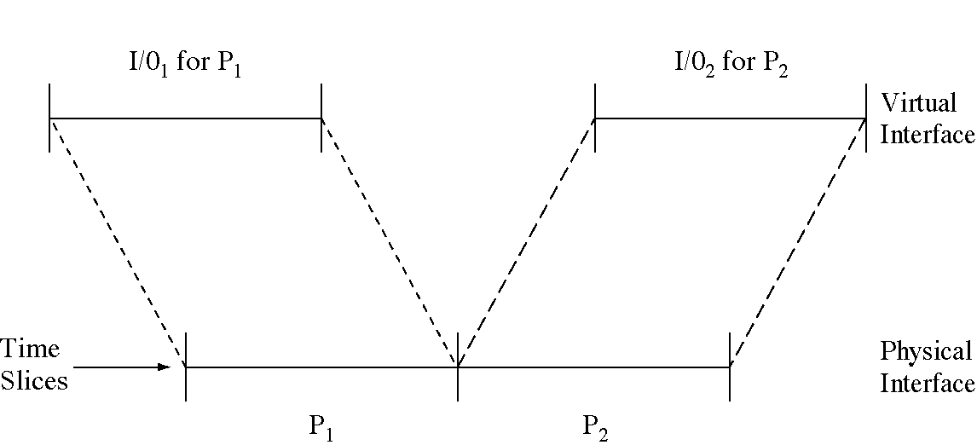
Time-multiplexing I/O devices

Slide 79
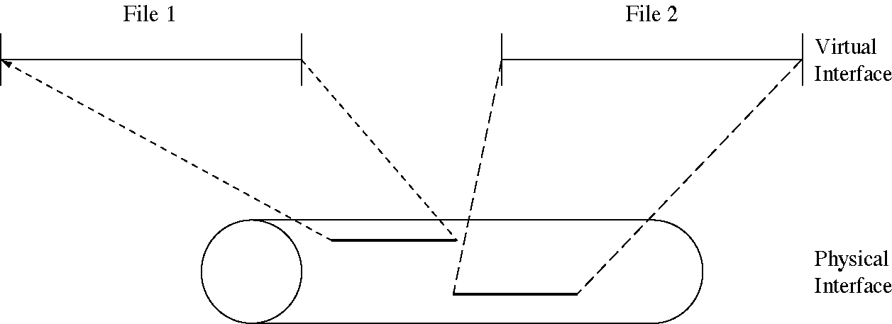
Space-multiplexing the disk

Slide 80
Do we need an OS?
Not always
  Some programs run “stand-alone”
But they are very useful
  Reusable functions
  Easier to use than the bare hardware

Slide 81
Metric prefixes
decisecond: 10⁻¹ sec.
centiecond: 10⁻² sec.
millisecond: 10⁻³ sec.
microsecond: 10⁻⁶ sec.
nanosecond: 10⁻⁹ sec.
picosecond: 10⁻¹² sec.
femptosecond: 10⁻¹⁵ sec.
attoseond: 10⁻¹⁸ sec.
dekabyte: 10¹ bytes
hectobyte: 10² bytes
kilobyte: 10³ bytes
megabyte: 10⁶ bytes
gigabyte: 10⁹ bytes
terabyte: 10¹² bytes
petabyte: 10¹⁵ bytes
exabyte: 10¹⁸ bytes

Slide 82
Operating Systems and hardware
Both have influence on each other
To facilitate the use of hardware, operating systems were developed.
As OSs were designed and used, it became obvious that changes in the design of hardware could simplify them.
So in the next lecture
  Review of Computer System Structures
    I/O structure and storage hierarchy
    Hardware protection
  Operating System Structures
    System components, services and system calls
    Virtual machines
    System design and implementation
Reading: Silberscatz/galvin: Chapters 2&3.

